Slide 1
IMDB Top 250 movies
Data analysis project by-
Sarthak shadangi

Slide 2
Data description
Shape- 250 rows, 14 columns
File type- .csv
Source- kaggle

Slide 3
Prerequisites & data cleaning
null handling
Data type casting of columns
Removal of irrelevant columns
Column handling of run time(hrs & mins)
New columns made by splitting w.r.t. delimiters
Error removal

Slide 4
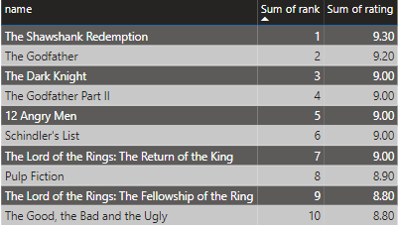
Top 10 movies rated by imdb

Slide 5
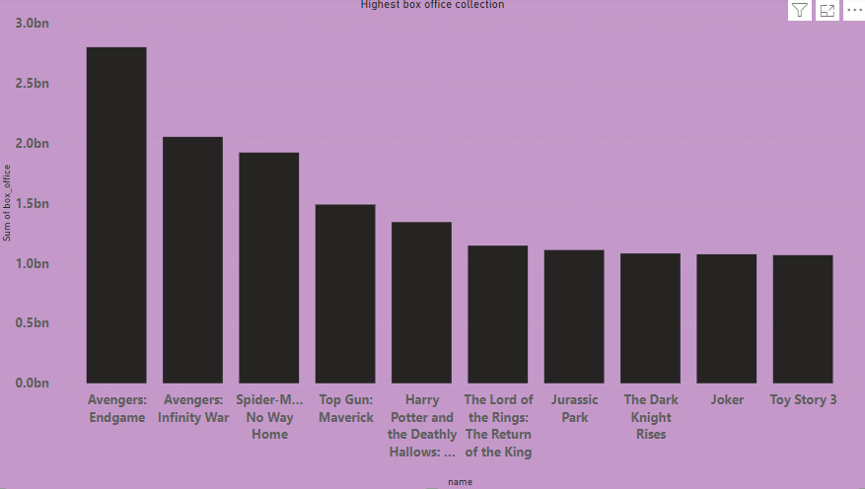
Highest box office collection

Slide 6
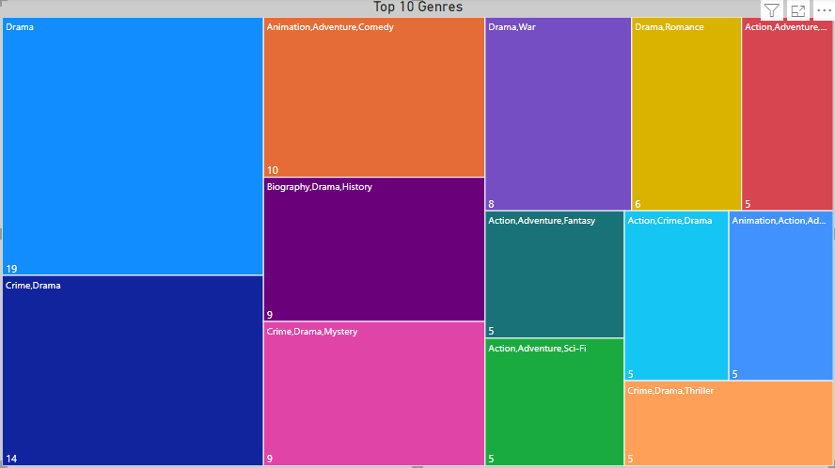
Top 10 genres

Slide 7
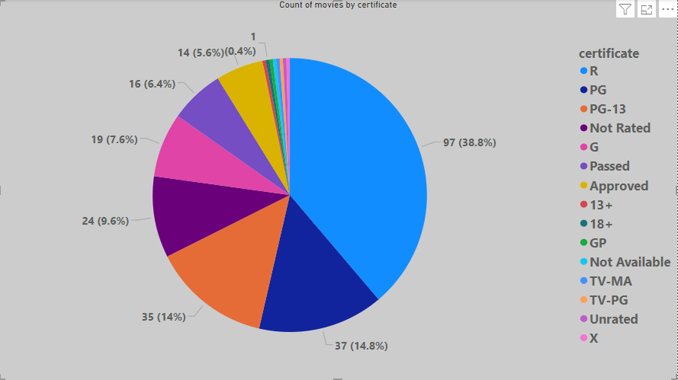
Count of movies certificate

Slide 8
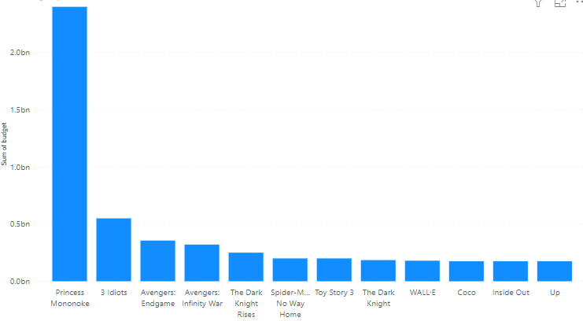
Films with highest budget

Slide 9
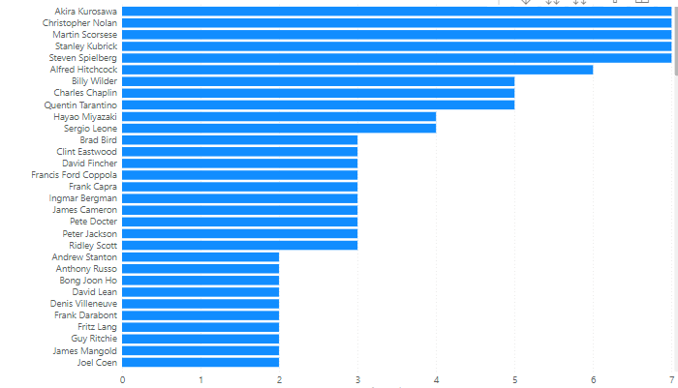
Directors with most movies in top 250

Slide 10
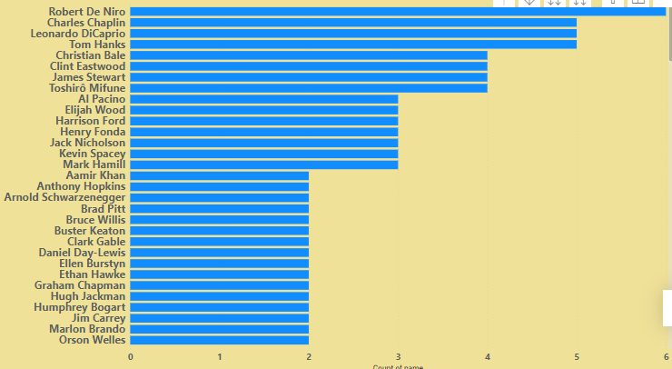
Actors in highest no. of top 250 movies

Slide 11
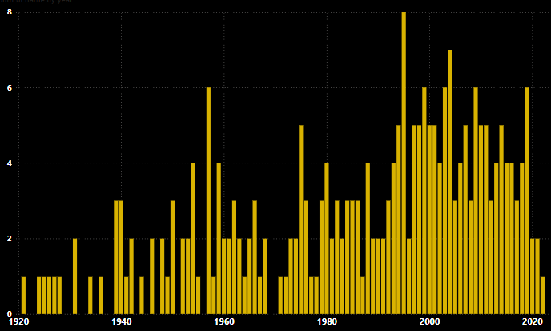
Years which yielded most no. of top movies

Slide 12
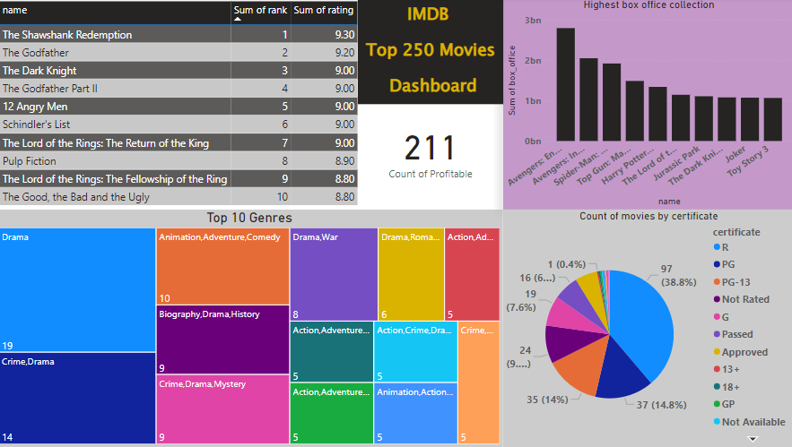
Power bi dashboard

Slide 13
Insights
The Shawshank redemption is the highest rated movie in the history of cinema.
The past 40 years of cinema has seen the most of the top movies produced in that time period.
Out of 250 movies, 211 movies turned out to be profitable.
Film with the highest budget is an animated movie i.e. princess Mononoke.
In the top 10 highest budget movies, 5 are animated movies.
akira Kurosawa, Christopher Nolan, martin Scorsese, steven speilberg are some of the directors with the highes number of movies in the top 250.
Marvel cinematic universe has the most no. of movies in the top 10 highest grossing movies.

Slide 14
Thank you for your time & patience

